Slide 1
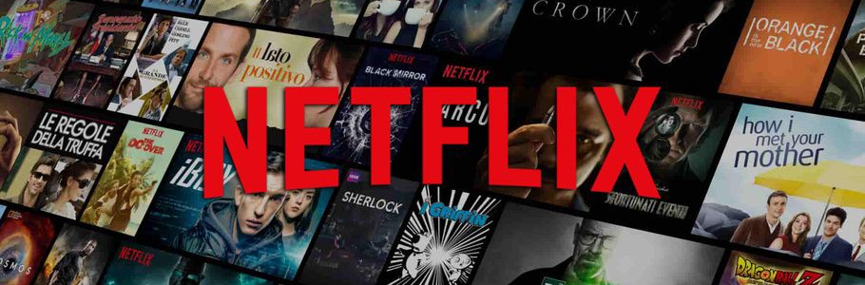

Netflix
Our Vision
NETFLIX DATA ANALYSIS:
At Netflix, we want to entertain the world. Whatever your taste, and no matter where you live, we give you access to best-in-class TV series, documentaries, feature films and mobile games. Our members control what they want to watch, when they want it, in one simple subscription.
We want to entertain the world

Slide 2
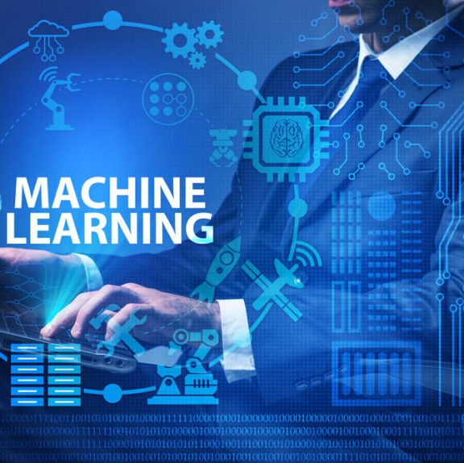
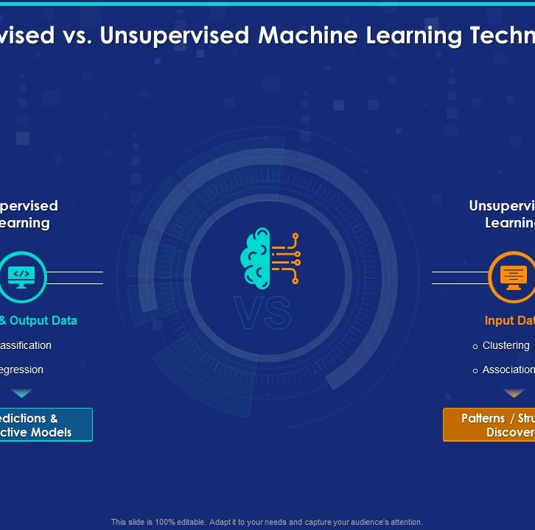
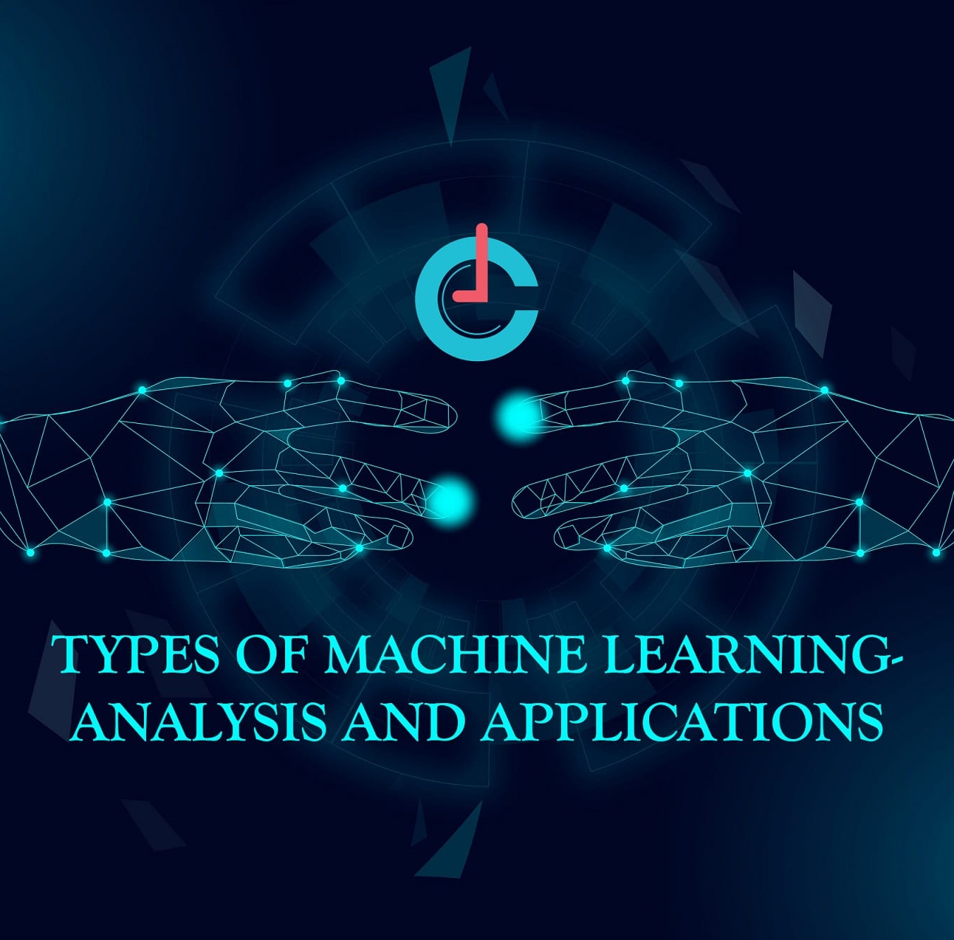
Three types of ML
Supervised Learning
Unsupervised Learning
Reinforcement Learning
o What is supervised Learning?
O Makes Machine Learn Explicitly
o Data with Clearly defined Output is given
o Direct feedback is given
o Predicts outcome/future
o Resolves Classification and Regression Problems
o What is Unsupervised Learning?
o Machine Understands the data (Identifies Patterns/ Structures)
o Evaluation is Qualitative or Indirect
o Does not Predict/Find anything Specific
Machine learning is a branch of artificial intelligence (AI) and computer science which focuses on the use of data and algorithms to imitate the way that humans learn, gradually improving its accuracy.

Slide 3

TV Shows & Movies
What is Netflix?
Netflix is a subscription-based streaming service that allows our members to watch TV shows and movies on an internet-connected device.
Depending on your plan, you can also download TV shows and movies to your iOS, Android, or Windows 10 device and watch without an internet connection.
If you're already a member and would like to learn more about using Netflix, visit Getting started with Netflix.
Get started
To start watching Netflix:
Visit netflix.com/signup.
Choose a plan.
Create an account by entering your email address and creating a password.
Enter a payment method.
As a Netflix member, you are charged once a month on the date you signed up.
Planes and Pricing

Slide 4
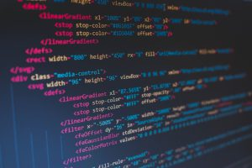
Challenges
Faced :
Setting up the work environment
Deciding what to write
Compiler Errors
Debugging the code

Slide 5
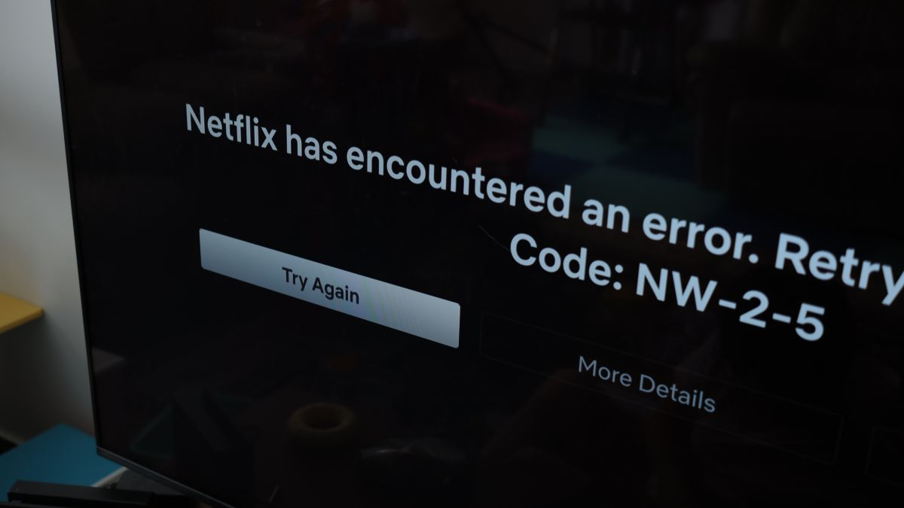
Limited Regional Selections. ...
Netflix Has an Outdated Library. ...
Internet Requirements. ...
Data Cap Consumption. ...
No Ownership of Media. ...
Subscription Value. ...
Loss of Channel Surfing.
Problem
Faced while using Netflix:

Slide 6
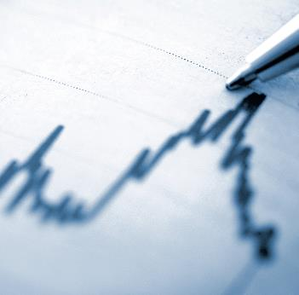

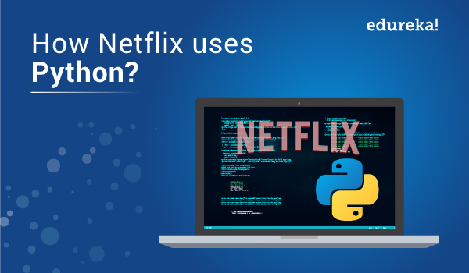
Solution
Approach:
Download Your Netflix Data
Familiarize Yourself with the Data
Load Your Data in any python module
Preparing the Data for Analysis (Ex: Colab,anaconda,IDLE)
Converting Strings to Datetime and Timedelta in Pandas
Filtering Strings by Substring in pandas Using str.contains
Filtering Out Short Durations Using Timedelta
Analyzing the Data

Slide 7
Libraries Used:
import warnings
Warning messages are typically issued in situations where it is useful to alert the user of some condition in a program, where that condition (normally) doesn’t warrant raising an exception and terminating the program.
import NumPy
NumPy is a Python library used for working with arrays. It also has functions for working in domain of linear algebra, Fourier transform, and matrices.
import pandas
Pandas is a game changer, and it is one of the most popular and commonly used tools in data analytics. Pandas is that it takes data from a CSV or TSV file or a SQL database and generates a Python object with rows and columns called a data frame, which looks remarkably similar to a table in statistics tools like Excel. Working with this is far more convenient than dealing with lists and/or dictionaries.

Slide 8
Libraries used:
import matplotlib
Matplotlib is a python library used to create 2D graphs and plots by using python scripts. It has a module named pyplot which makes things easy for plotting by providing feature to control line styles, font properties, formatting axes etc.
import seaborn
The import seaborn portion of the code tells Python to bring the Seaborn library into your current environment. The as sns portion of the code then tells Python to give Seaborn the alias of sns. This allows you to use Seaborn functions by simply typing sns.function_name rather than seaborn.function_name.
Import Tensorflow
You can use tf. function to make graphs out of your programs. It is a transformation tool that creates Python-independent dataflow graphs out of your Python code. This will help you create performant and portable models, and it is required to use SavedModel .

Slide 9
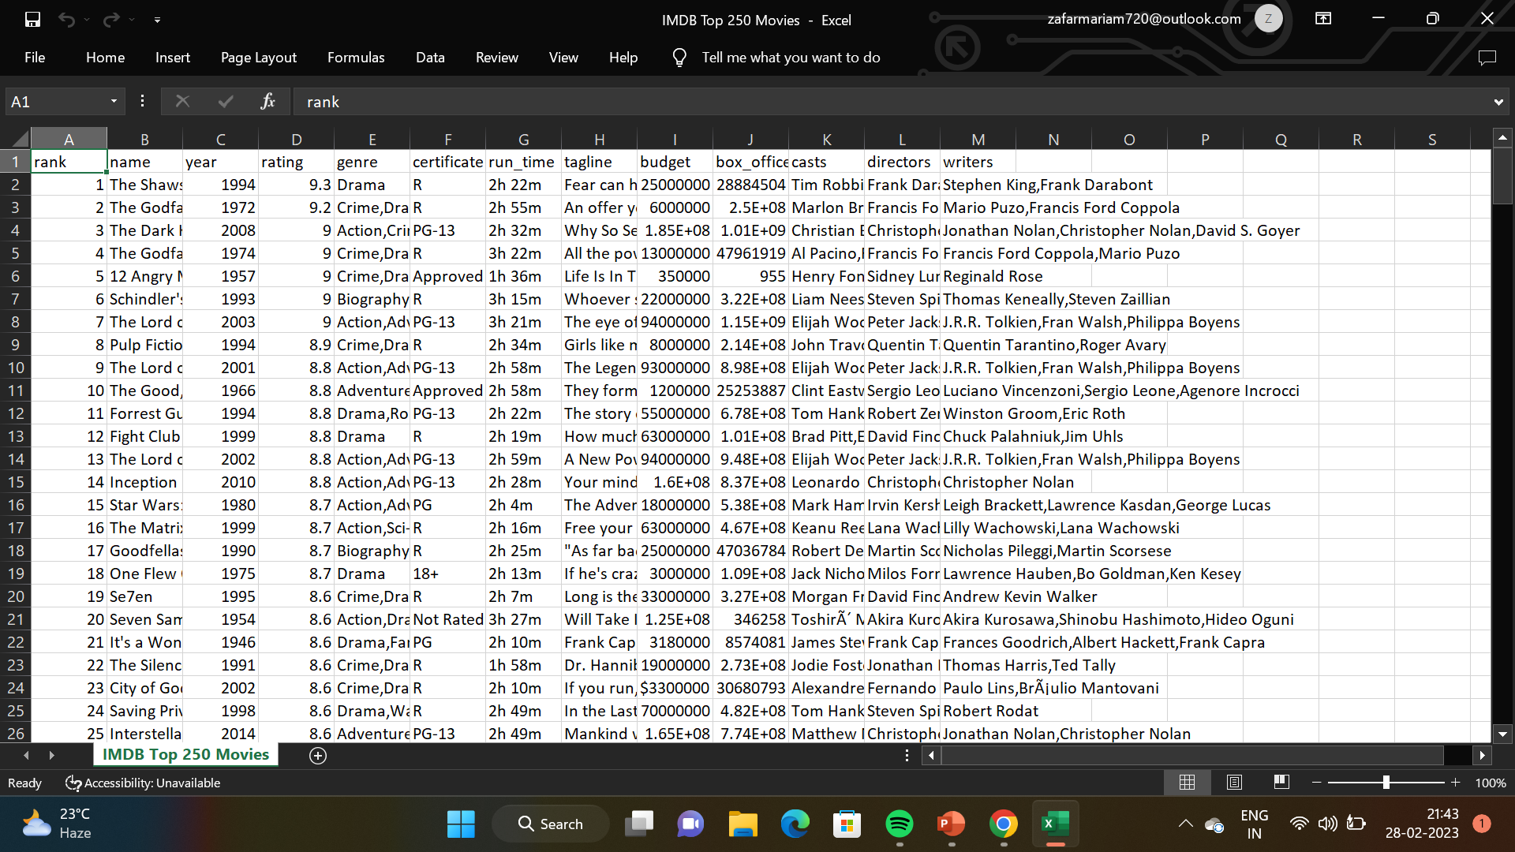
Datasets:
The data we have used in this project was in csv.file. It was taken from Kaggle.com . The dataset consists of 7789 rows and 11 columns with no null values. Column data consist of independent Features. The independent features contain both categorical and numeric values.

Slide 10
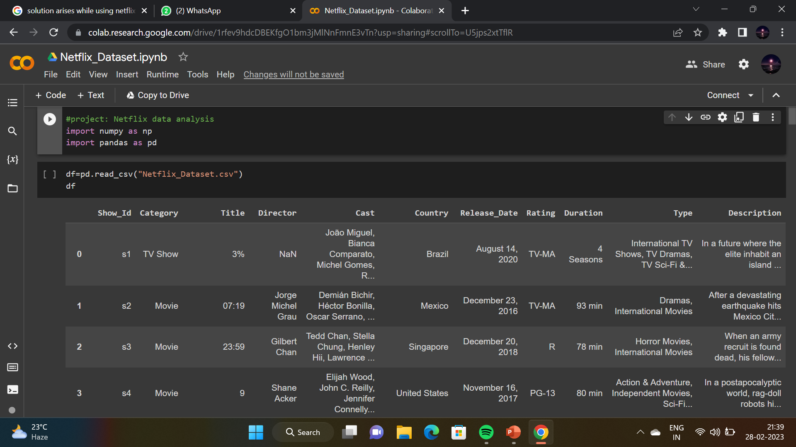

Data reading:
It is the data that we need to load for starting any of the ML project. With respect to data, the most common format of data for ML projects is CSV (comma-separated values). Basically, CSV is a simple file format which is used to store tabular data (number and text) such as a spreadsheet in plain text.

Slide 11
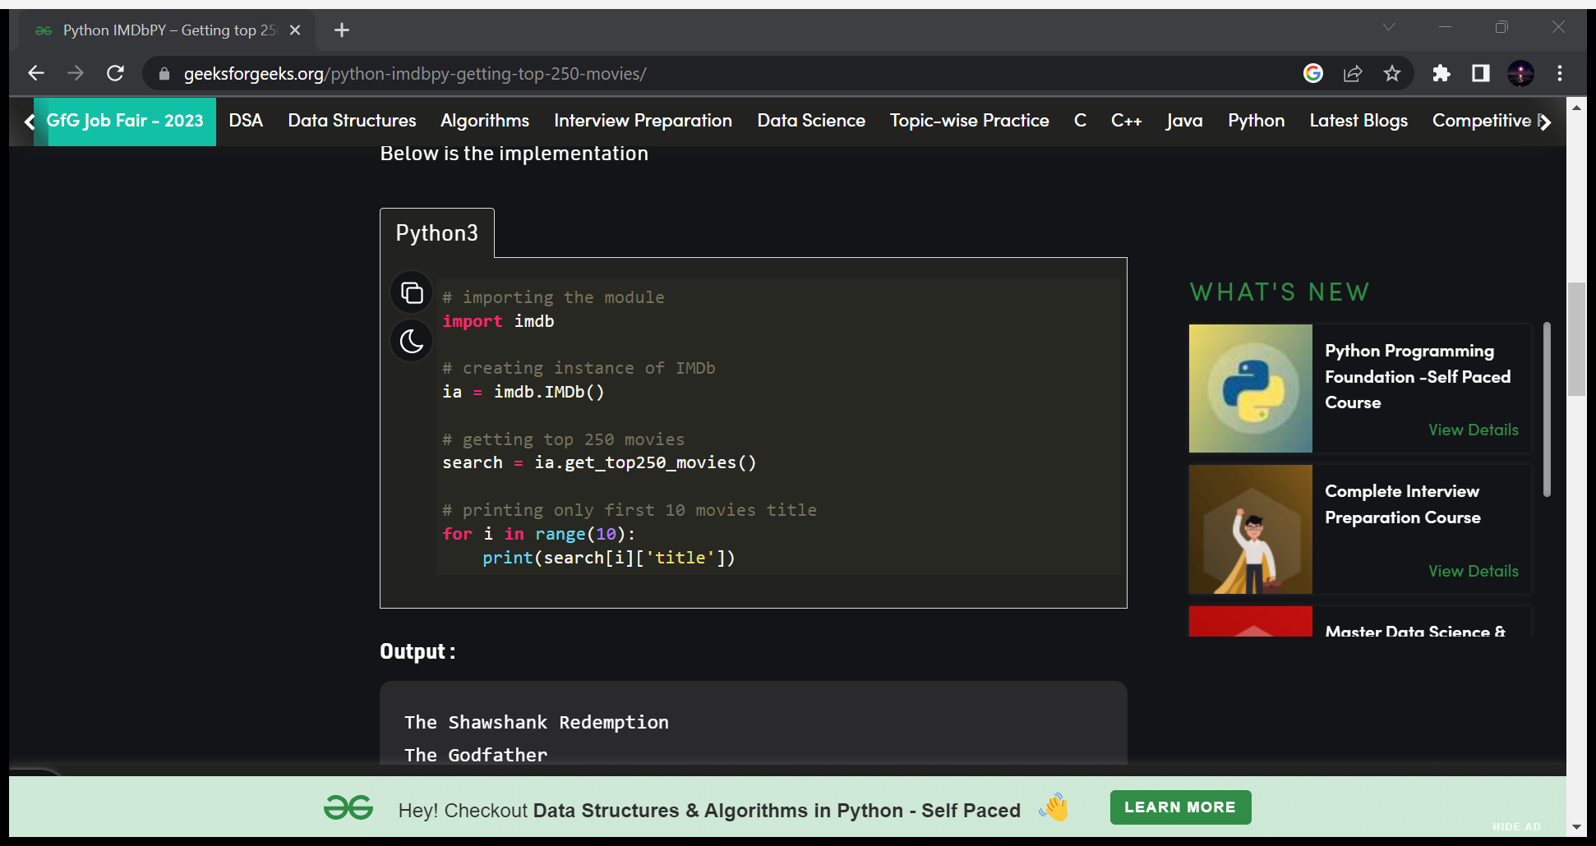
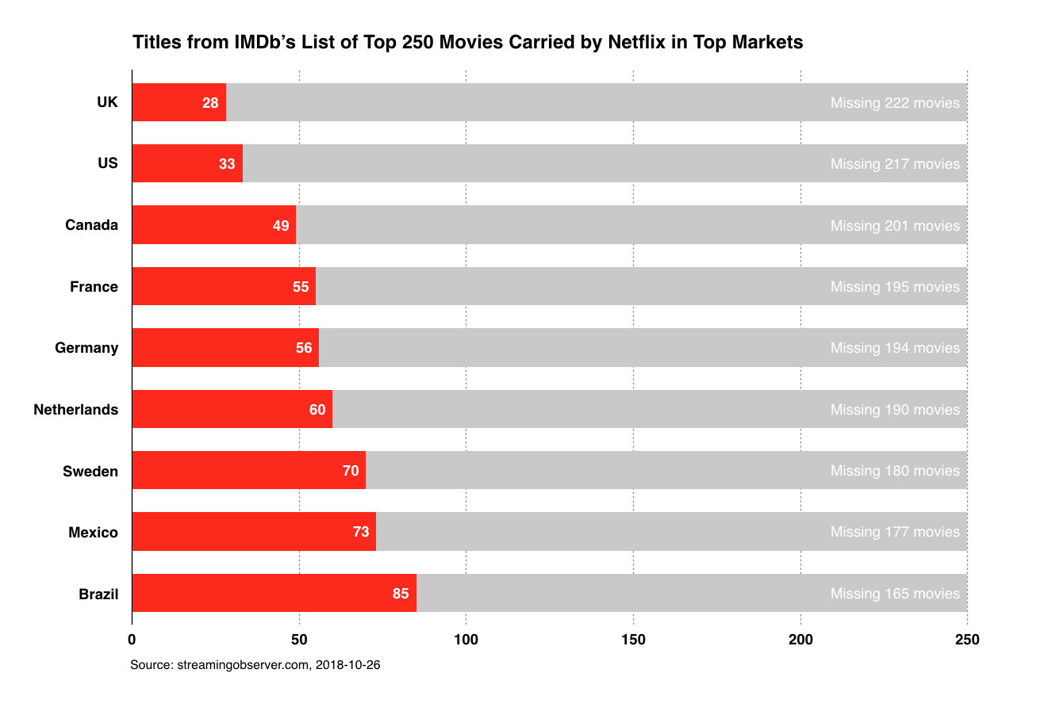
DATA VISUALIZATION:
Data visualization is a graphical representation of quantitative information and data by using visual elements like graphs, charts, and maps.

Slide 12
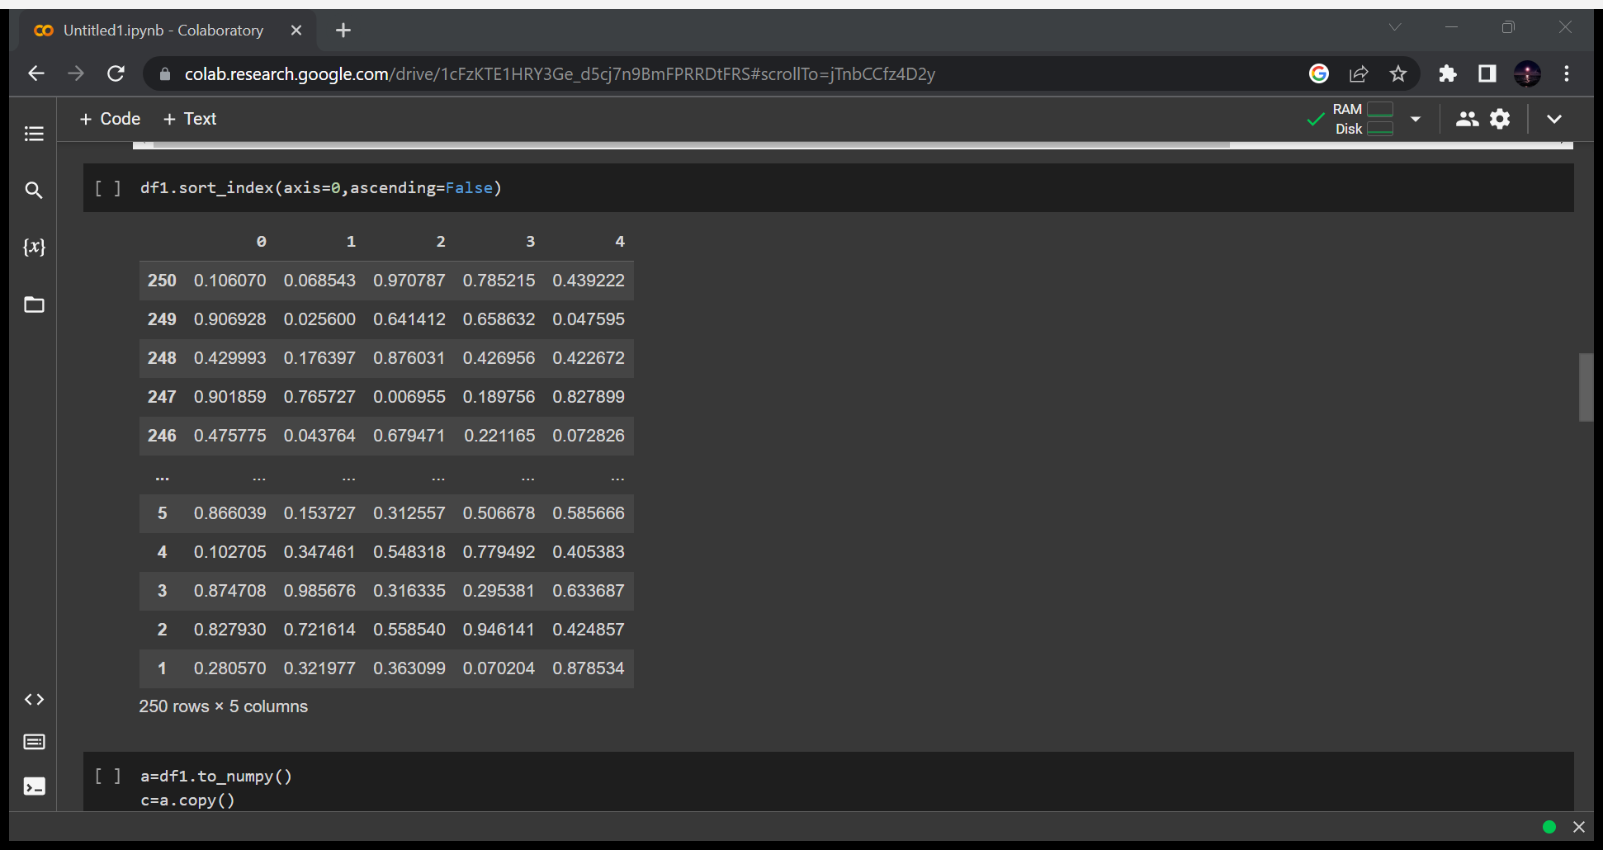
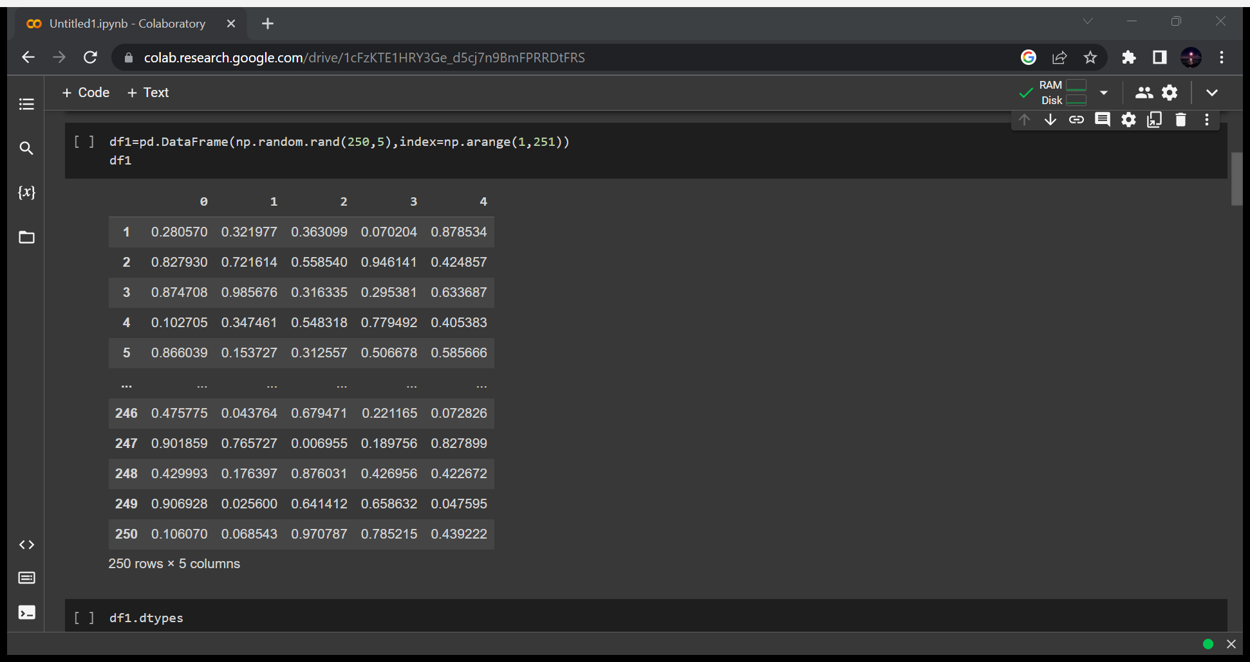
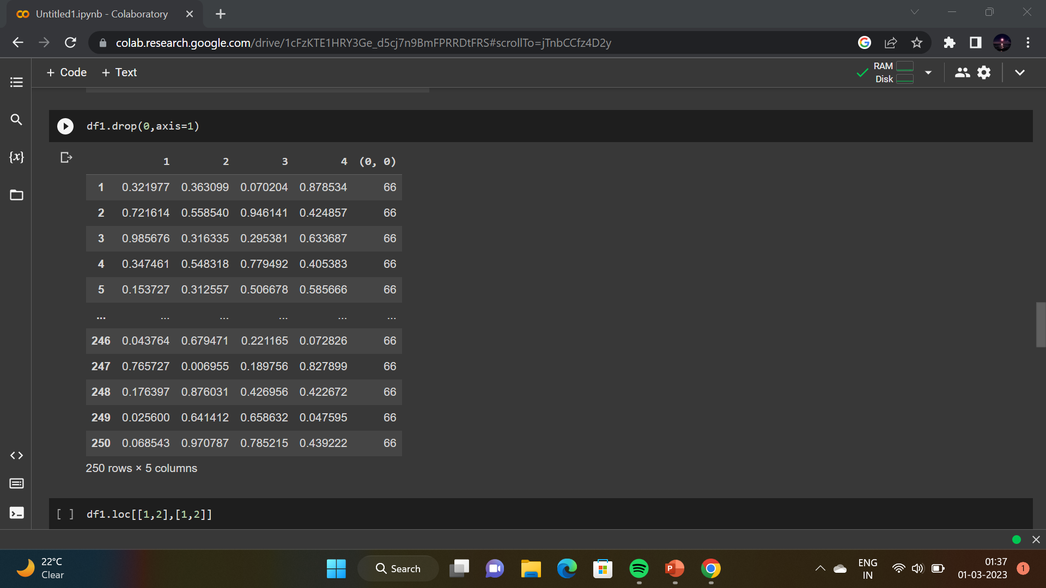

Other python functions:

Slide 13
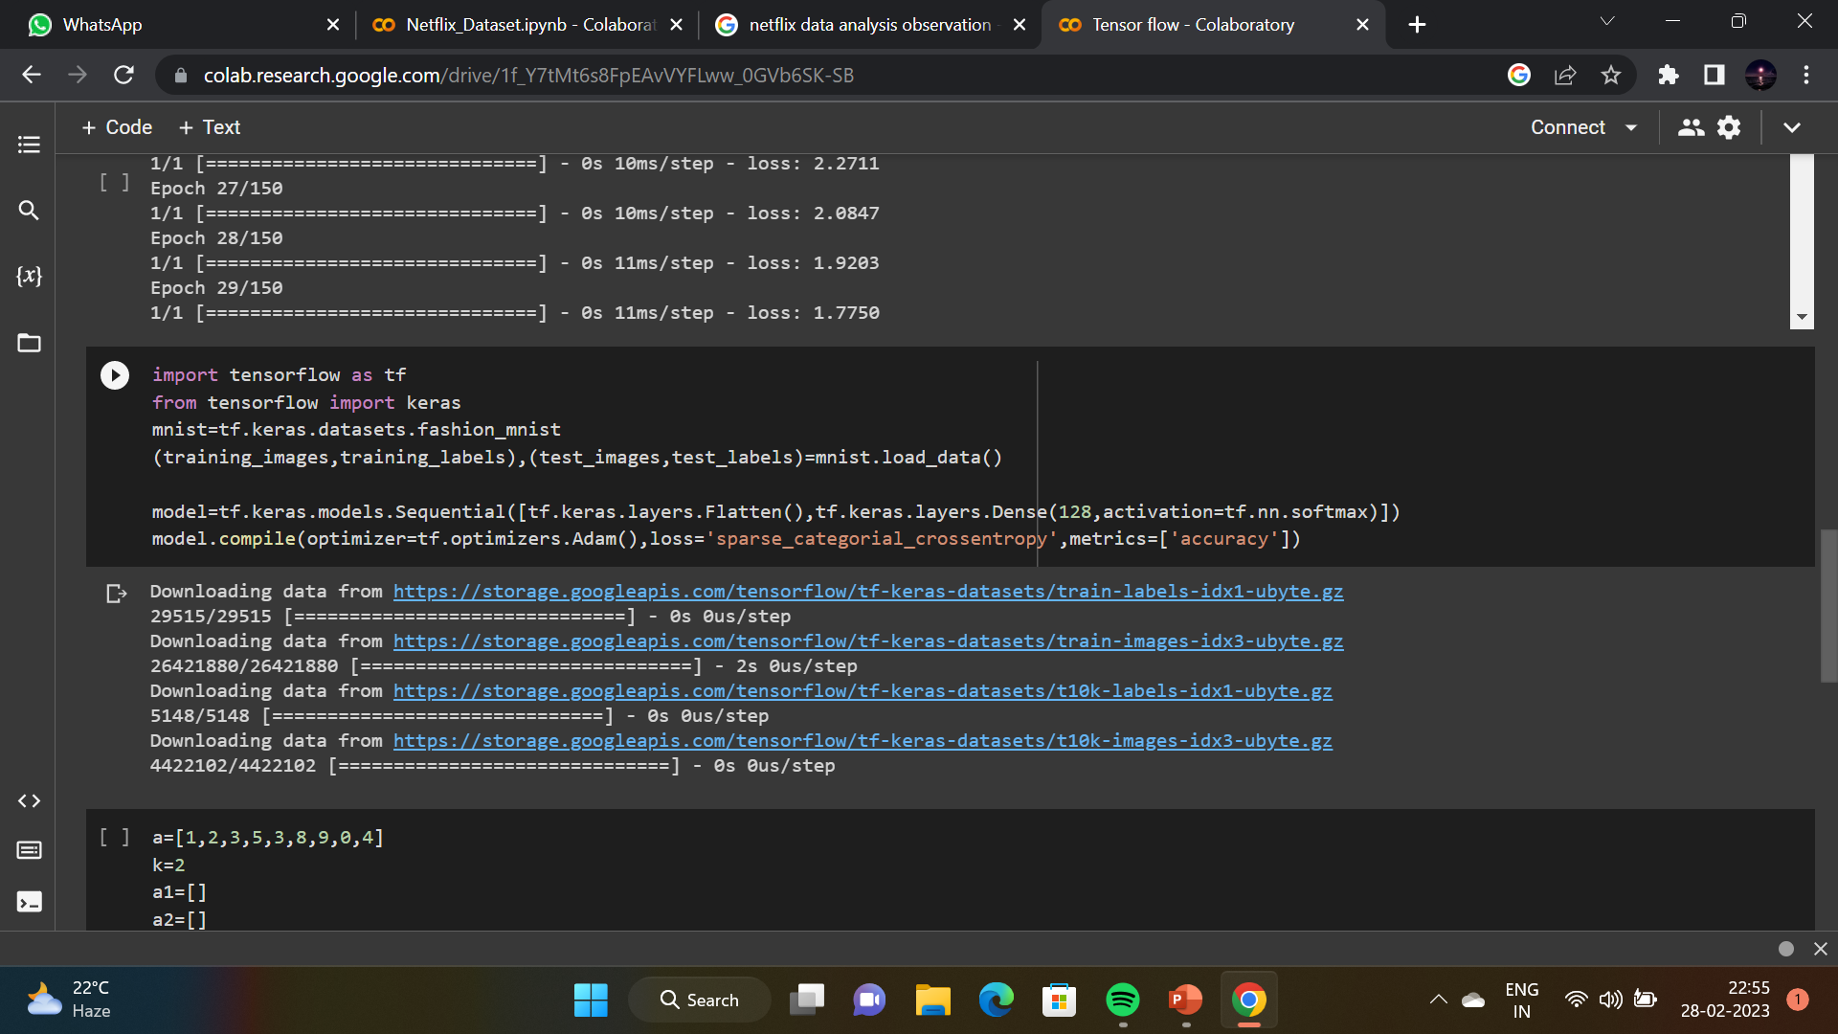
TENSOR FLOW:
TensorFlow is basically a software library for numerical computation using data flow graphs where:
nodes in the graph represent mathematical operations. edges in the graph represent the multidimensional data arrays (called tensors) communicated between them.

Slide 14
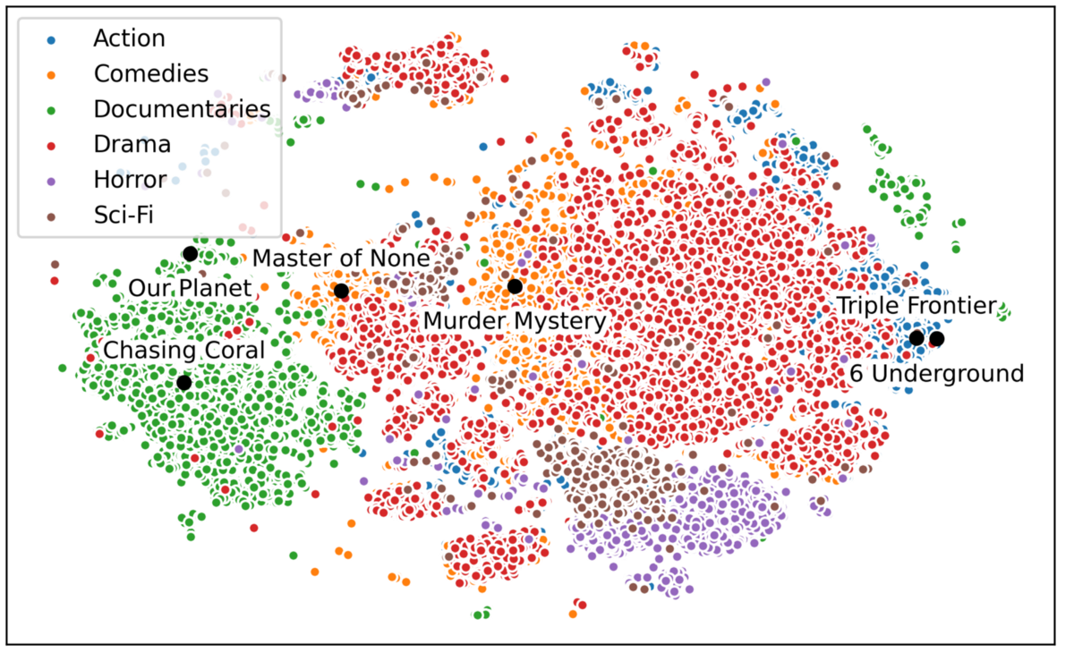
OBSERVATION:
In this project,
First we have imported different type of python module.
Then after getting the output of dataset ,we have cleaned the dataset that whether the dataset has any null value or duplicate value or not
Then we have done data preprocessing before doing data visualization
Data visualization ,we have done it through different kind of data plotting ,also by using 3d plotting.
Thus by this following steps we observe different kind of plotting and by comparing different kind of labelled data and we have plotted it .

Slide 15
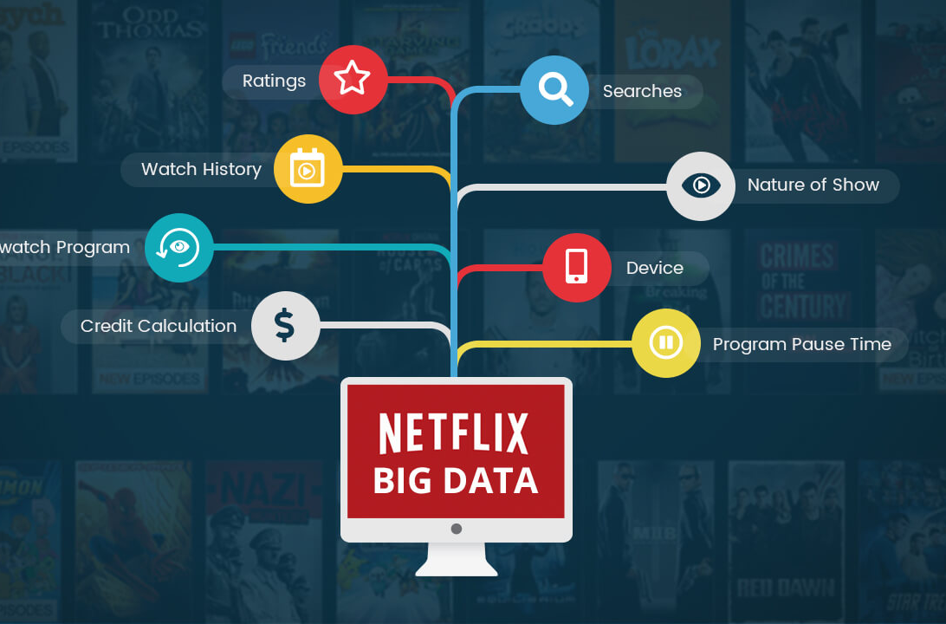
RESULTS
Project name : NETFLIX DATA ANALYSIS [Group 1X]
CONTRIBUTION:
1.Mariam Zafar(11900121113)
2.Rinky Kumari(11900121086)
3.Shreya Sah(11900121130)
4.Swagata Dey(11900121087)

Slide 16
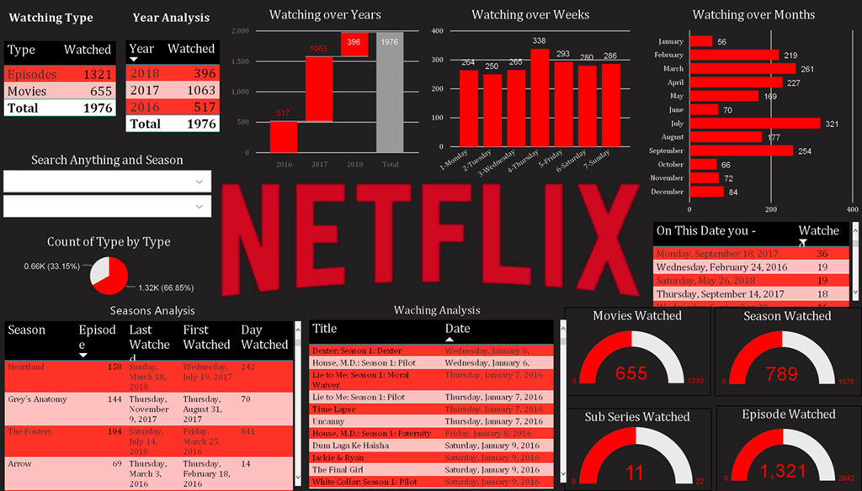
Conclusion:
Netflix uses AI-powered algorithms to make predictions based on the user's watch history, search history, demographics, ratings, and preferences. These predictions shows with 80% accuracy what the user might be interested in seeing next.

Slide 17


